Slide 1
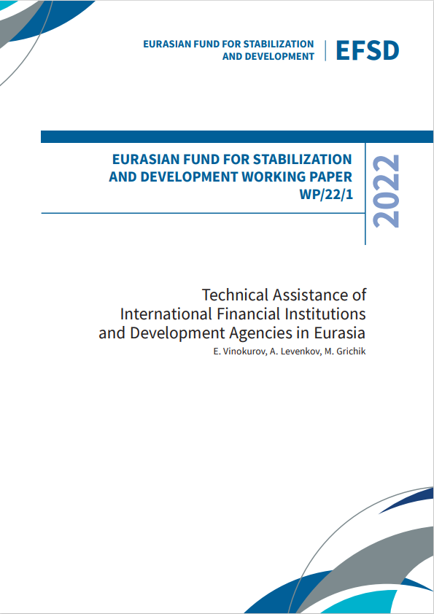
Working Paper WP/22/1
Technical Assistance of International Financial Institutions and Development Agencies in Eurasia
Chief Economist Group
October 2022
The electronic version of this document is available at https://efsd.org/en/research/working-papers/

Slide 2
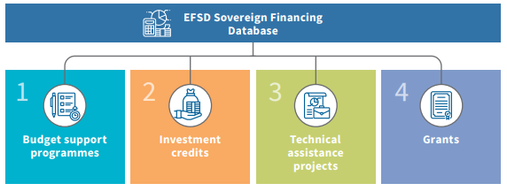
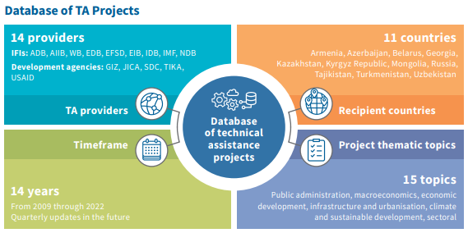
Sovereign Financing Database in Eurasia
Work on the EFSD Sovereign Financing Database builds on the analysis of the functioning of the Global Financial Safety Net.
EFSD Sovereign Financing Database is compiled from public data from IFIs and development agencies, their country strategies, annual reports, and mission reports
Useful for the donor community and recipient countries - source of systemic information by country/ sector/ type/ year etc.
2848 | TA projects in the EFSD Sovereign Financing Database (72,7% of all projects)

Slide 3
Working Paper Structure
1. We used data from the EFSD Sovereign Financing Database
3. We structured information on IFIs and development agencies’ approaches and tools for TA.
5. We introduced TA as a new EFSD tool
2. We highlighted trends, motivation and shortcomings of TA assistance.
4. We reviewed TA projects in Eurasia region, EFSD countries in particular

Slide 4
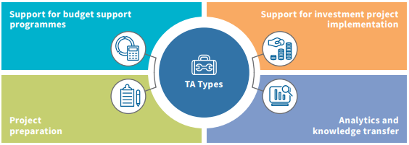
Technical Assistance definition and modalities
TA means the transfer, adaptation, and utilisation of services, skills, knowledge, and technologies to/by a recipient state for the purposes of: (i) conducting policy research and providing advisory assistance; (ii) supporting project preparation and implementation; and (iii) ensuring sustainable improvement of the economic, management, and institutional capacity of the TA recipient state in the framework of investment credits and government structural and institutional reform programmes supported with IFI credits.
TA modalities:
embedding technical experts in government bodies to develop their capacity and/or support organisational change;
embedding technical experts within assistance projects to design and implement the projects;
providing policy advice, often accompanying ODA;
providing advice on the impact assessment for government legislation and regulations.

Slide 5
Trends in TA projects provision and criticism of it
Trends in TA provision
Lack of data on the nature, scope, and goals of TA.
Quality of monitoring and evaluation.
Low transparency of TA operations.
High costs of consultancy services.
Overly ambitious TA projects.
TA Criticism
Improved responsibility by TA recipient states
Expanded engagement of national consultants and a shorter time-frame for project implementation
Improved coordination and integration: TA programmes are closely coordinated with national development programmes
Shifting the focus towards capacity development
Application of the case-by-case approach to TA project implementation
Enhanced transparency of TA activities of IFIs

Slide 6
Approaches and TA Tools used by IFIs and Development Agencies
Each IFI determines its standards and procedures for TA, ranging from the procedure for TA approval to the thematic areas of such assistance. TA programmes contribute to the achievement of goals and objectives set out in country strategies. TA is one of the key tools used by IFIs to provide Official Development Assistance and contribute to the achievement of the Sustainable Development Goals.
EFSD database of sovereign financing includes activities of 9 IFIs and 5 development agencies.

Slide 7
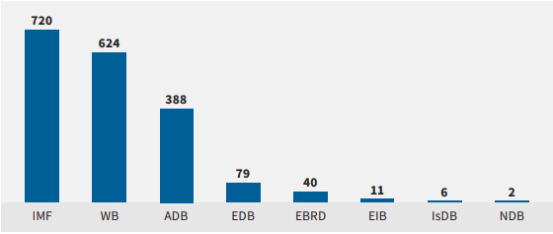
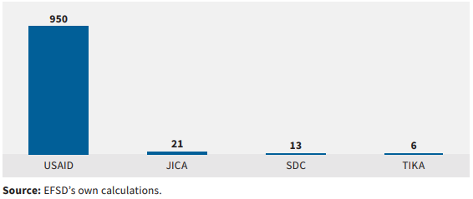
Activity of IFIs and development agencies
2848 | TA projects in Eurasia in the Database (quarterly updated)
IFIs | 65% | 35% | development agencies
92,5% | of 1872 IFIs’ TA projects were implemented by three major IFIs — the IMF, WB, and ADB
95% | of 976 development agencies’ TA projects were implemented by USAID (the number of TA programmes of other agencies is much smaller, largely due to the low transparency)

Slide 8
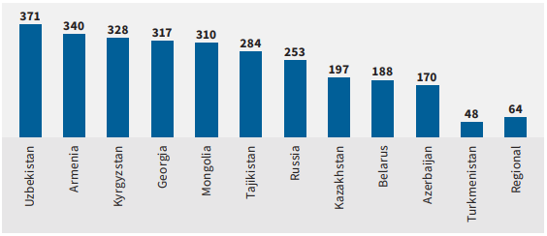
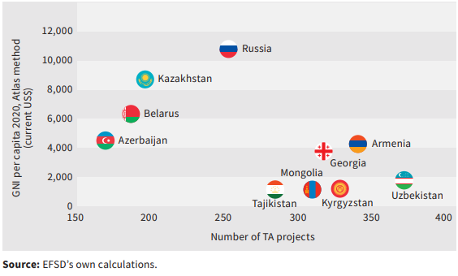
Technical Assistance to EFSD Member States
In Eurasia, 1,590 TA projects were implemented in the EFSD member states in the analysed period, while Azerbaijan, Georgia, Mongolia, Turkmenistan, and Uzbekistan accounted for a total of 1,216 TA projects, and 64 projects covered several countries of the region.
Armenia is the leader among the EFSD member states in the number of TA projects, accounting for 340 projects or 21.4% of all projects implemented in the EFSD region. The Kyrgyz Republic comes in second (328 projects, 20.6%), and Tajikistan is third (284 projects, 17.9%).
The negative correlation between the GNI per capita and the number of TA projects was (–0.59). It is also noteworthy that the correlation between the number of TA projects in the sample in general and the Human Development Index turned out to be much lower (0.13).

Slide 9
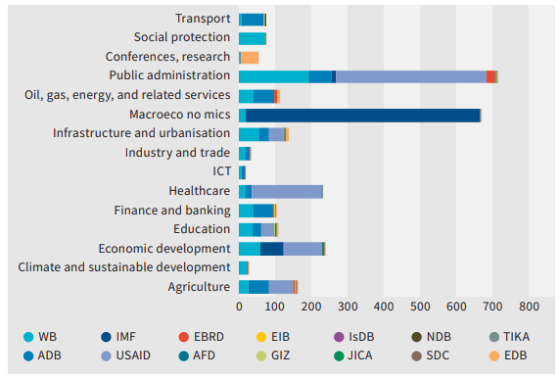
Topics of TA projects
All IFIs have their own project classifications by topic, which are often not comparable. Therefore, based on expert judgement, we have identified 15 thematic areas, under which projects were grouped by thematic topic.
In terms of sectors, the most common groups of thematic topics were those bringing together structural issues — public administration (709 TA projects), macroeconomics (667), and economic development (238). In aggregate, they accounted for 56% of the total number of TA projects.
In terms of thematic topics, the WB has the most diversified pool of projects, which were implemented in all 15 selected thematic groups. The ADB comes second, with projects in 11 of the 15 selected thematic groups. The WB and ADB play leading roles in shaping government policies in the energy sector and infrastructure development.

Slide 10
Technical Assistance to EFSD Member States (1/2)
 | Armenia | Belarus | Kazakhstan
Number of TA projects | 340 | 188 | 197
Main donors | IMF — almost 100 projects (Fiscal — 55, Monetary — 22, Statistics — 20, Law — 2) World bank — 69 Asian Development Bank— 29 USAID - 131 | World Bank— 80, IMF — 48, (Fiscal — 13, Monetary — 29, Statistics — 6,) EBRD — 2, EIB — 2. USAID — 55 | USAID - 76, World Bank- 39, ADB – 35, IMF – 36, EBRD – 6, EDB – 4, IsDB – 1.
Main topics | Public administration (104) Macroeconomics (98) Health (USAID and WB projects) — 26, infrastructure and urbanization (WB, ADB, USAID, EIB) — 20, education (USAID, АDB, WB) — 13. | Mainly support of structural and macroeconomic policies. Wide range of sectoral topics. | Macroeconomics – 39, Public administration – 37 Economic development - 30, Health - 24, Finance and banking - 24, Agriculture - 8, Oil, gas, energy and related services- 7.

Slide 11
Техническое содействие в государствах — участниках ЕФСР (2/2)
 | Kyrgyzstan | Russia | Tajikistan
Number of TA projects | 328 | 253 | 284
Main donors | ADB – 36, IMF – 72 (Monetary — 28, Statistics — 22, Law — 22), … | World Bank— 69, USAID — 170, EDB— 12, NDB — 2. | World Bank— 86, USAID — 85, IMF — 68, ADB — 31, ЕАБР и ЕБРР — по 2 проекта. JICA — 5 проектов, SDC — 2 проекта. ИБР — 3
Main topics | Macroeconomics – 91, Economic Development– 53, Agriculture– 27, Energy – 11, | Public Administration (implemented mainly by USAID). 2 NDB projects in transport. WB implemented projects in 11 different areas. | Public Administration — 73, Macroeconomics — 67, Agriculture— 28, Economic Development — 22, Health — 22, Infrastructure and urbanization — 12, Social protection and transport— 10 each, Oil, gas, energy— 9.

Slide 12
Technical Assistance as a New Tool of the EFSD
The current objectives for all the countries in 2022-2026 are to:
The choice of topics is due to their high relevance for the recipient states, as well as the availability of expertise in the EFSD
Promote macroeconomic and financial stability
Priority thematic topics of the EFSD TA:
☑ | public finance management
☑ | tax policy and tax administration
☑ | fiscal and quasi-fiscal risk management
Assist in rehabilitating physical infrastructure
Support structural and institutional reforms
Promote the development of
social sectors
In 2022 consultations were initiated to launch pilot TA projects using the grant facility. If approved by the management bodies of the Fund, their recipients will be the Republic of Armenia, the Kyrgyz Republic, and the Republic of Tajikistan.

Slide 13
Chief Economist Group
evinokurov@efsd.org
alevenkov@efsd.org
mgrichik@efsd.org +7 495 645 04 45 # 12 34 +7 123 456 48 90

